Slide 1

2022 Winter
UPDATA AI Study
Chap 3. Imformed search
Image from CS188 of Klein and Abbee

Slide 2

Informed Search
Image from CS188 of Klein and Abbee

Slide 3



Search Heuristics
A heuristic is:
A function that estimates how close a state is to a goal
Designed for a particular search problem
Examples: Manhattan distance, Euclidean distance for pathing
10
5
11.2
Image from CS188 of Klein and Abbee

Slide 4
Example : Heuristic Function
Heuristic: the number of the pancakes that are still out of place
h(x)
3
4
3
4
3
0
4
4
3
4
4
2
3
Slide credit: CS188 of Klein and Abbee

Slide 5
Manhattan Distance

Slide 6
Greedy Search
Strategy: expand a node that you think is closest to a goal state
Heuristic: estimate of distance to nearest goal for each state
A common case:
Best-first takes you straight to the (wrong) goal
Worst-case: like a badly-guided DFS
b
…
b
…
[Demo: contours greedy empty (L3D1)]
[Demo: contours greedy pacman small maze (L3D4)]
Slide credit: CS188 of Klein and Abbee

Slide 7
A* Search : Combining UCS and Greedy
Uniform-cost orders by path cost, or backward cost g(n)
Greedy orders by goal proximity, or forward cost h(n)
A* Search orders by the sum: f(n) = g(n) + h(n)
S
g = 0 h=6
8
g = 1 h=5
a
e
h=1
1
g = 2 h=6
g = 9 h=1
b
d
g = 4 h=2
e
S
1
a
3
d
2
G
h=6
1
h=5
h=2
h=0
g = 3 h=7
g = 6 h=0
g = 10 h=2
1
c
G
d
c
b
h=7
h=6
G
g = 12 h=0
Example: Teg Grenager
Slide credit: Klein and Abbee

Slide 8
A* Search
When should A* terminate?
Is A* optimal?
Should we stop when we enqueue a goal?
No: only stop when we dequeue a goal
What went wrong?
Actual bad goal cost < estimated good goal cost
We need estimates to be less than actual costs!
How about h at a Goal state?
h=0
h = 2
2
A
2
S
h = 3
h = 0
G
2
B
3
h = 1
Slide credit: Klein and Abbee

Slide 9


Admissible Heuristic
Inadmissible (pessimistic) heuristics break optimality by trapping good plans on the fringe
Admissible (optimistic) heuristics slow down bad plans but never outweigh true costs
Slide credit: Klein and Abbee

Slide 10
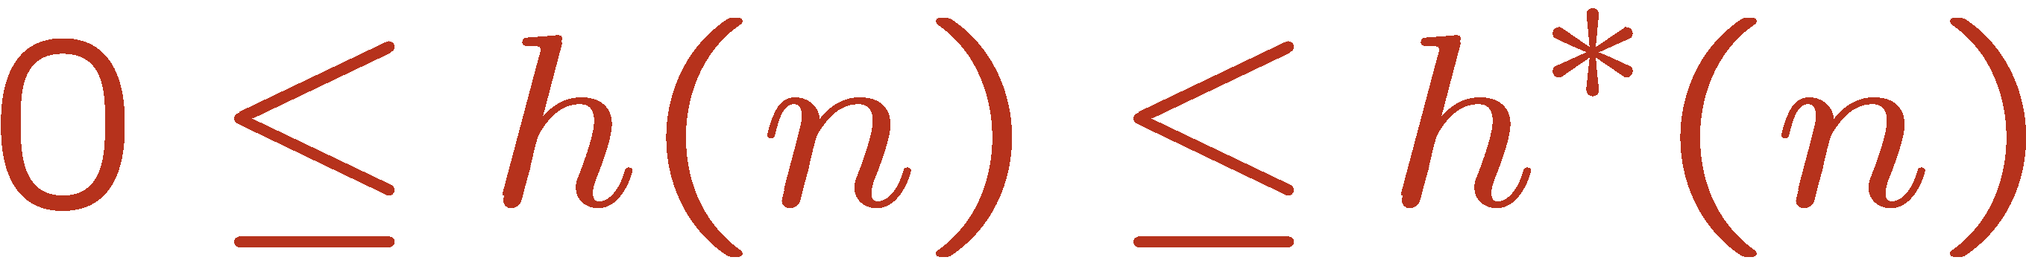

Admissible Heuristic
A heuristic h is admissible (optimistic) if:
where is the true cost to a nearest goal.
h=0 <= h* trival admissible heurstic. Also h=0 at goal State statisfies.
Examples:
Coming up with admissible heuristics is most of what’s involved in using A* in practice.
4
15
Slide credit: Klein and Abbee

Slide 11
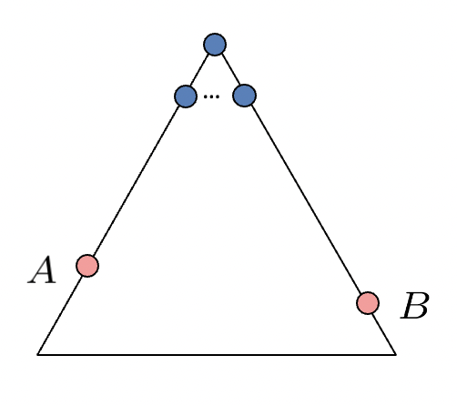
Optimality of A* Tree Search
Assume:
A is an optimal goal node
B is a suboptimal goal node
h is admissible
Claim:
A will exit the fringe before B
Slide credit: Klein and Abbee

Slide 12
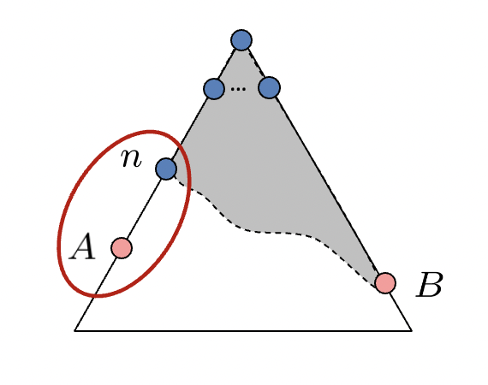

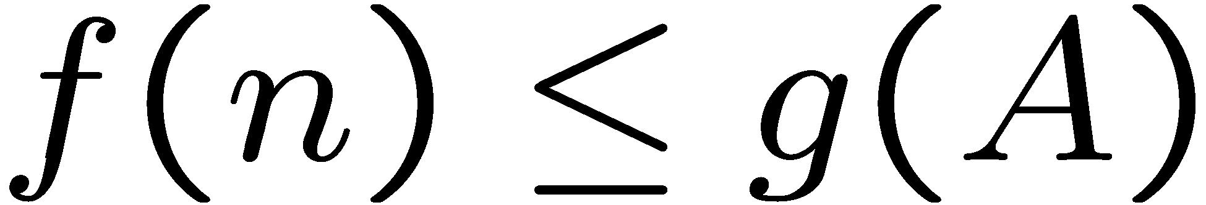
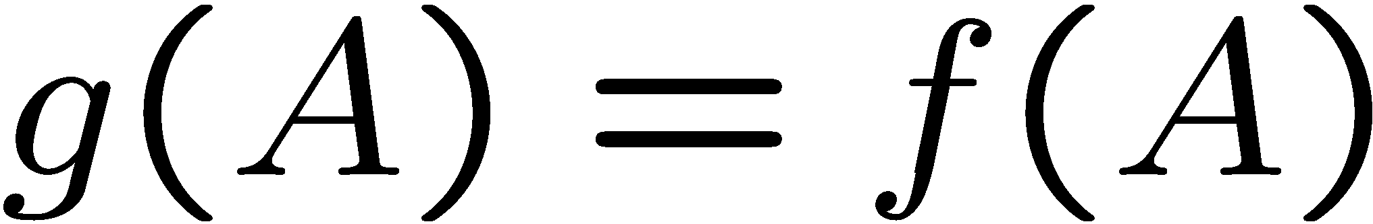
Optimality of A* Tree Search: Blocking
Proof:
Imagine B is on the fringe
Some ancestor n of A is on the fringe, too (maybe A!)
Claim: n will be expanded before B
f(n) is less or equal to f(A)
f(A) is less than f(B)
n expands before B
All ancestors of A expand before B
A expands before B
A* search is optimal
Definition of f-cost
Admissibility of h
h = 0 at a goal
Slide credit: Klein and Abbee

Slide 13
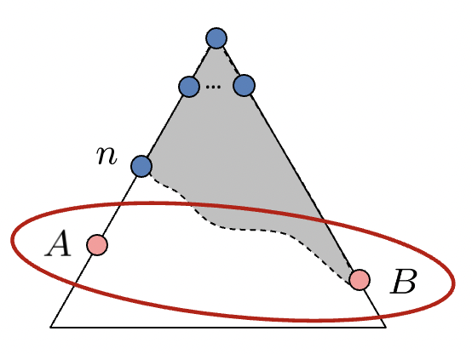


Optimality of A* Tree Search: Blocking
Proof:
Imagine B is on the fringe
Some ancestor n of A is on the fringe, too (maybe A!)
Claim: n will be expanded before B
f(n) is less or equal to f(A)
f(A) is less than f(B)
n expands before B
All ancestors of A expand before B
A expands before B
A* search is optimal
B is suboptimal
h = 0 at a goal
Slide credit: Klein and Abbee

Slide 14
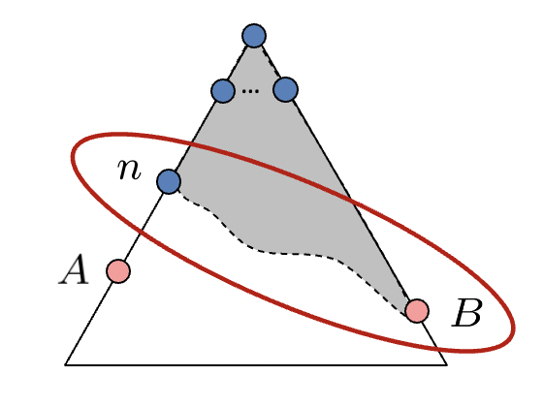
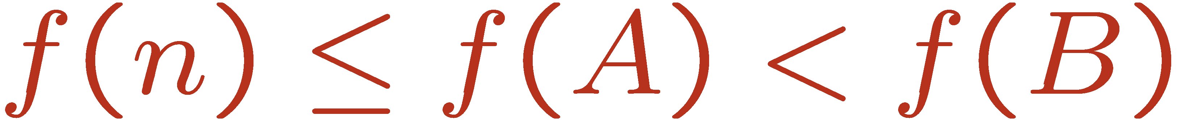
Optimality of A* Tree Search: Blocking
Proof:
Imagine B is on the fringe
Some ancestor n of A is on the fringe, too (maybe A!)
Claim: n will be expanded before B
f(n) is less or equal to f(A)
f(A) is less than f(B)
n expands before B
All ancestors of A expand before B
A expands before B
A* search is optimal
Slide credit: Klein and Abbee

Slide 15
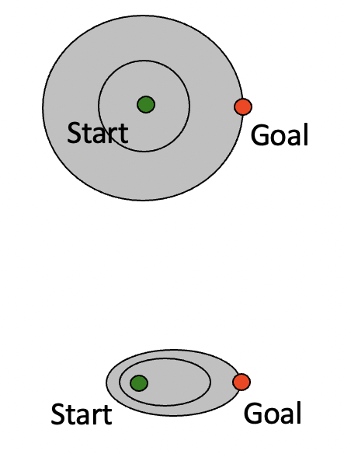
UCS vs A* Contour
Uniform-cost expands equally in all “directions”
A* expands mainly toward the goal, but does hedge its bets to ensure optimality
Slide credit: Klein and Abbee

Slide 16

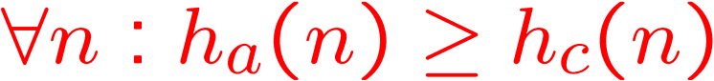
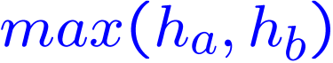
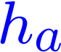
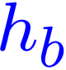
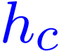

Dominance
Dominance: h_{a} ≥ h_{c} if
Heuristics form a semi-lattice:
Max of admissible heuristics is admissible
Trivial heuristics
Bottom of lattice is the zero heuristic (what does this give us?)
Top of lattice is the exact heuristic
Slide credit: Klein and Abbee

Slide 17
A* graph search
State space graph
Search tree
A
S (0+2)
S
1
1
h=4
C
h=1
A (1+4)
B (1+1)
h=2
1
2
B
3
C (2+1)
C (3+1)
h=1
G
G (5+0)
G (6+0)
h=0
Slide credit: Klein and Abbee

Slide 18
Consistency of Heuristics
Main idea: estimated heuristic costs ≤ actual costs
Admissibility: heuristic cost ≤ actual cost to goal
h(A) ≤ actual cost from A to G
Consistency: heuristic “arc” cost ≤ actual cost for each arc
h(A) – h(C) ≤ cost(A to C)
Consequences of consistency:
The f value along a path never decreases
h(A) ≤ cost(A to C) + h(C)
A* graph search is optimal
A
1
C
h=4
h=1
h=2
3
G
Slide credit: Klein and Abbee

Slide 19

Optimality
Tree search:
A* is optimal if heuristic is admissible
UCS is a special case (h = 0)
Graph search:
A* optimal if heuristic is consistent
UCS optimal (h = 0 is consistent)
Consistency implies admissibility
In general, most natural admissible heuristics tend to be consistent, especially if from relaxed problems
Slide credit: Klein and Abbee

